Slide 1
Case Study: Data Engineering Consultancy for XYZ Retail Corp.
Gina Mastrorilli, Peter Alonzo & Andy Amoah Mensah
Group 1
Instructed by: Tarek Atwan

Slide 2
Executive Summary
On-Premise | Snowflake
Requires On Site Servers | Cloud-Based Infrastructure
Limited Scalability - Requires Hardware Investments | Scale Up or Down Based on Demand
High IT Maintenance Costs | Cloud Manages Updates, Backup & Security
Limited Disaster Recovery | Built-in Redundancy & Disaster Recovery
Flat Monthly Rate + Future Costs | Usage-Based Billing

Slide 3
Technical Proposal : Data Migration Strategy
Planning
Assess Current Infrastructure:
Understand the structure, size, and complexity of the on-premise data warehouse
Defining Migration:
Everything gets moved and transformed according to department needs
Extracting Data: AWS Services
Utilize AWS DataSync and AWS Direct Connect to transfer the large amounts of data between on premises storage & AWS storage services.
Transformation Data: AWS Glue
Schema Conversion:
Adjusting data types, formats, or structures to match snowflake's requirement
Data Cleaning:
Removing duplicates, handing null values, or applying business rules to the data
Loading Data to Snowflake:
Utilize Snowpipe for near-real-time ingestion of new data.
For Large datasets that don't require immediate processing consider using COPY INTO

Slide 4
Technical Proposal: Storage Solutions
Recommended XYZ Data Types
Structured Data:
Transactional Data: Financial records or inventory management
Relational Data Models: For Data organized in a tabular or thoughtspot
Unstructured:
For Storing & Processing data files like JSON files, image files, Parquet files
Semi-Structured Data:
Query-ability: consistent access patterns and to leverage SQL for querying
Use of Stages
External Stage:
Connect to Unstructured Data and Data in S3
Internal Stage:
Temporary Data Processing:
Intermediate data generated during complex ETL processes
Data Sharing Across Workgroups:
Sharing data between teams or workgroups securely within Snowflake.

Slide 5
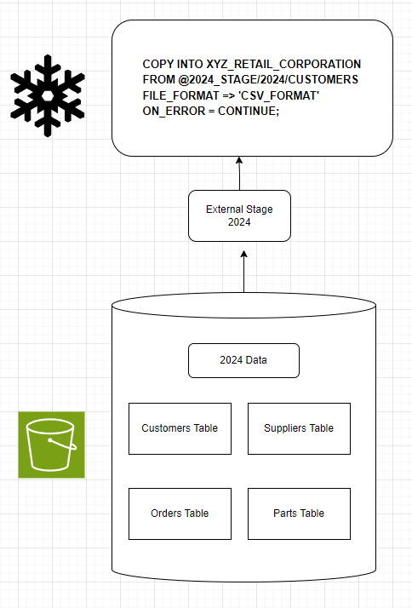
Technical Proposal: Data Ingestion Phases 1 & 2
Phase 1: Data Organization
Organize by Year On-Prem
Phase 2: Bulk Loading
Connect to S3 with an External Stage
CREATE TABLE
COPY INTO SQL Query

Slide 6
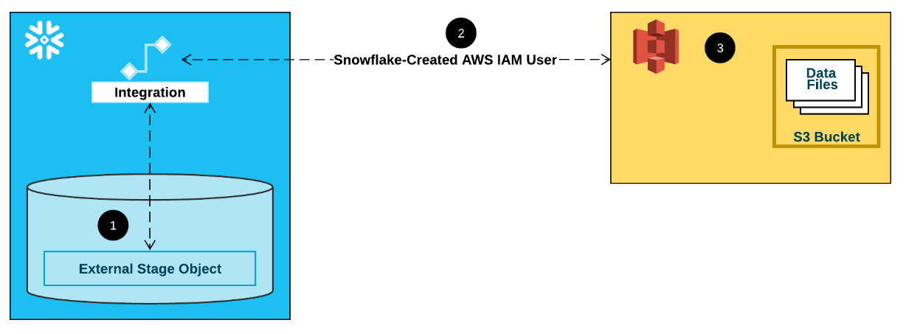
Technical Proposal: Data Ingestion Phases 3 & 4
Phase 3: Snowpipe
Automate Continuous Loading from S3
Near Real Time Ingestion
Phase 4: Validation
Check for Duplicates, Null Values, Type Matches, Number of Records, etc.
Ensure Accurate Results
Utilize of Temporary Tables

Slide 7
Technical Proposal: Optimization Techniques
File Format and Compression:
Choose efficient file formats (e.g., Parquet, ORC) and compression codecs to reduce storage space and improve load times
Ex: Parquet = compression
Load Granularity:
Break down large loads into smaller, more manageable parts to parallelize the loading process and reduce overall load times.
Materialized Views:
Identify complex and frequently executed queries that can benefit from pre-computation.
This reduces the load on the system and speeds up query execution times.

Slide 8

Technical Proposal: Data Security and Governance
Row Access Policies:
XYZ can create row access policies to only show necessary rows to different data teams
Ex: Rows with 2010-2015 sales for historical analysis team
Data Masking:
XYZ can utilize data masking to protect columns in tables containing PII
Customer privacy and data integrity will be protected long-term
AWS Access Control:
IAM is AWS' built-in tool for controlling access to cloud services
XYZ can create admin and team roles for data teams to regulate access to sensitive data
Identity and Access Management (IAM)

Slide 9










Architecture Diagram
Old Data Warehouses
Network Transfer
AWS Cloud
DataSync
(Sender)
Internet
On-Premises Servers
DataSync
(Receiver)
S3 Storage
ETL Tools
Direct Connect
Data Visualization Tools (Cloud)
Kinesis
Glue

Slide 10
Implementation Plan: Timeline and Key Milestones
Timeline Estimation: 2-3 years depending on amount of data on-premises
Key Milestones:
(01/01/2025) Preparation of On-Premise Resources Complete
(06/01/2025) Data Migration to S3 Complete
(09/01/2025) Initial Data Migration to Snowflake Complete
(12/01/2025) Beta Test on Snowflake
(03/01/2026) Final Migration to Snowflake
(06/01/2026) On-Premise Resources Diminished

Slide 11
Implementation Plan
Deliverables:
(3-6 months) Data Leaders will decide what data should be kept long-term
(3-6 months) Partition Data by year & Bulk Load partitioned data in S3
(2-3 months) Create external stages in Snowflake for every year
(1-2 months) Establish data governance rules
(3-6 months) Scale down or close on-premises data centers
Potential Risks/Setbacks:
Data teams will need time and company resources for training on AWS and Snowflake
Snowflake may be more costly than expected based on amount of data
Budget flexing is needed to ensure data accuracy and proper uploading to the cloud before shutting down on-premises

